Slide 1
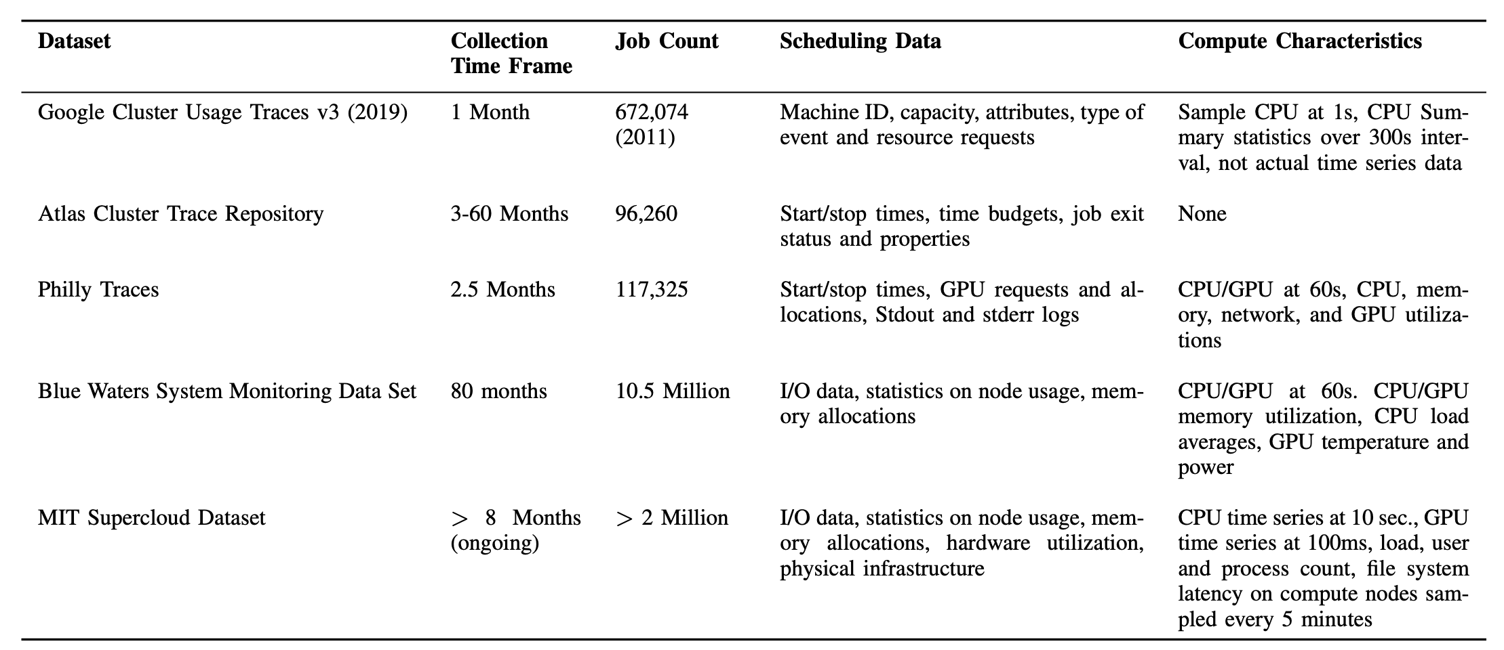
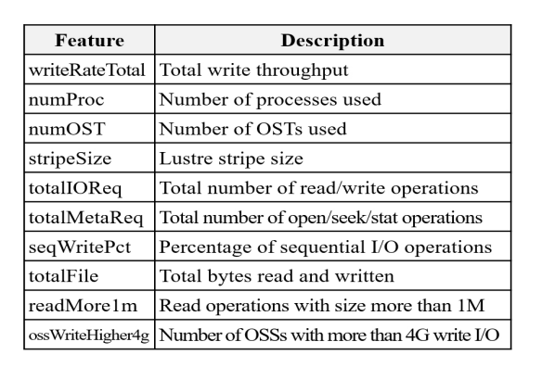
The MIT Supercloud Workload Classification Challenge
Workload classification helps to identify compute characteristics of unknown workloads and either present optimization pathways or alternatives to resource scheduling to minimize waste.
2. Other Data:
J. Wilkes, “More Google cluster data.” [Online]. Available: https: //ai.googleblog.com/2011/11/more-google-cluster-data.html
J. Wilkes and C. Reiss, “Clusterdata 2011 traces.” [Online]. Available: https://github.com/google/cluster-data/blob/master/ ClusterData2011 2.md
J. Wilkes, “Clusterdata 2019 traces.” [Online]. Available: https: //github.com/google/cluster-data/blob/master/ClusterData2019.md
G. Amvrosiadis, M. Kuchnik, J. W. Park et al., “The atlas cluster trace repository,” Usenix Mag., vol. 43, no. 4, 2018.
M. Jeon, S. Venkataraman, A. Phanishayee et al., “Analysis of large-scale multi-tenant GPU clusters for DNN training workloads,” CoRR, vol. abs/1901.05758, 2019. [Online]. Available: http://arxiv.org/ abs/1901.05758
NCSA, “Blue waters data sets.” [Online]. Available: {https://bluewaters. ncsa.illinois.edu/data-sets}
Background:
J. Bang, C. Kim, K. Wu et al., HPC Workload Characterization Using Feature Selection and Clustering. New York, NY, USA: Association for Computing Machinery, 2020, p. 33–40.
No data
Unsupervised learning
1). Feature selection Methods: Mutual Information Regression, F Regression, Decision Tree, Extra tree
2). Clustering algorithms: KMeans Clustering, Gaussian Mixture Model, Ward Linkage Clustering
Notes:
在计算出矩阵X后，Gavel使用一个基于轮询的调度机制为每个模型分配资源，在每一个round结束后，会根据X(m, j)/模型m在加速器j上已经分配的时间片计算优先级，根据优先级高低决定下一轮的资源分配：

Slide 2
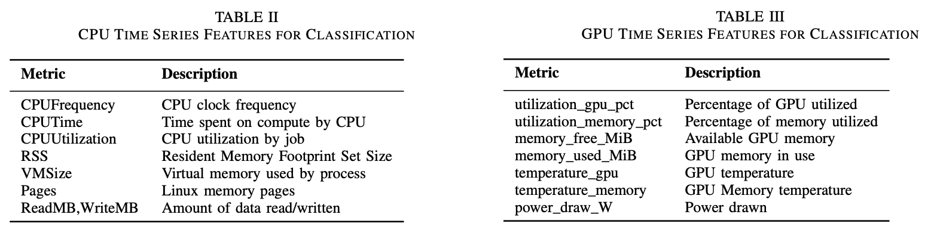
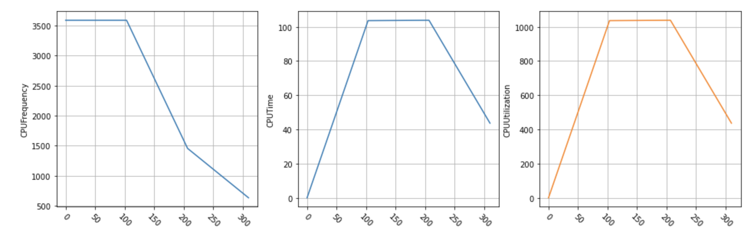
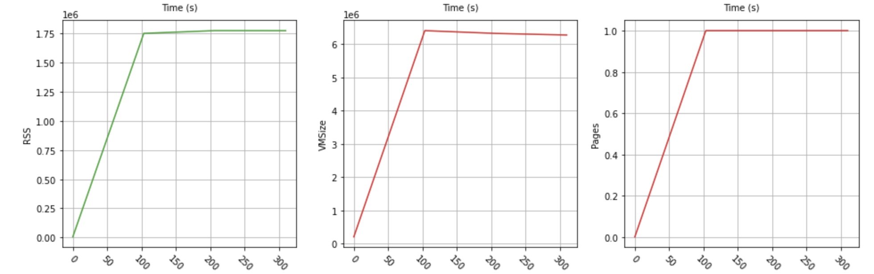
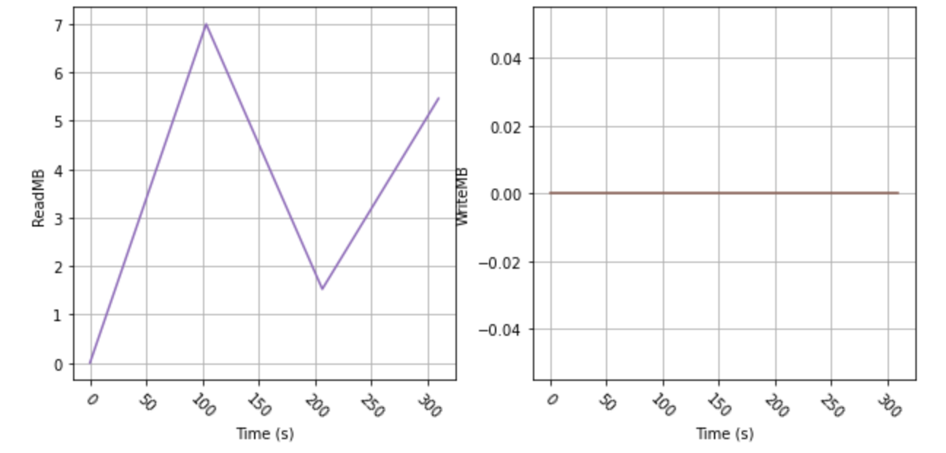
The MIT Supercloud Workload Classification Challenge
Workload classification helps to identify compute characteristics of unknown workloads and either present optimization pathways or alternatives to resource scheduling to minimize waste.
Data:
The MIT Supercloud Dataset consists of anonymized scheduler logs, time series data from CPUs and GPUs, monitoring data from each compute node. The uncompressed dataset is of the order of a Terabyte and is made available in compressed files. The dataset includes traces from 460,497 jobs, out of which 98,177 are jobs that requested GPUs for a variety of compute workloads which include AI/ML training and inference.
CPU:
The `cpu` folder contains time-series profiling data collected using the Slurm profiler plugin on each node assigned to a job included in this dataset. The data is organized in 100 subfolders. Each CSV file in the archive contains CPU usage, memory usage and file read/write data collected at 10 second intervals. Also included is a summary of the usage data for each job in the corresponding folder.
How to use the CPU data: https://nbviewer.org/github/MIT-AI-Accelerator/MIT-Supercloud-Dataset/blob/main/notebooks/Intro-to-MIT-Supercloud-Dataset.ipynb
Notes:
在计算出矩阵X后，Gavel使用一个基于轮询的调度机制为每个模型分配资源，在每一个round结束后，会根据X(m, j)/模型m在加速器j上已经分配的时间片计算优先级，根据优先级高低决定下一轮的资源分配：

Slide 3
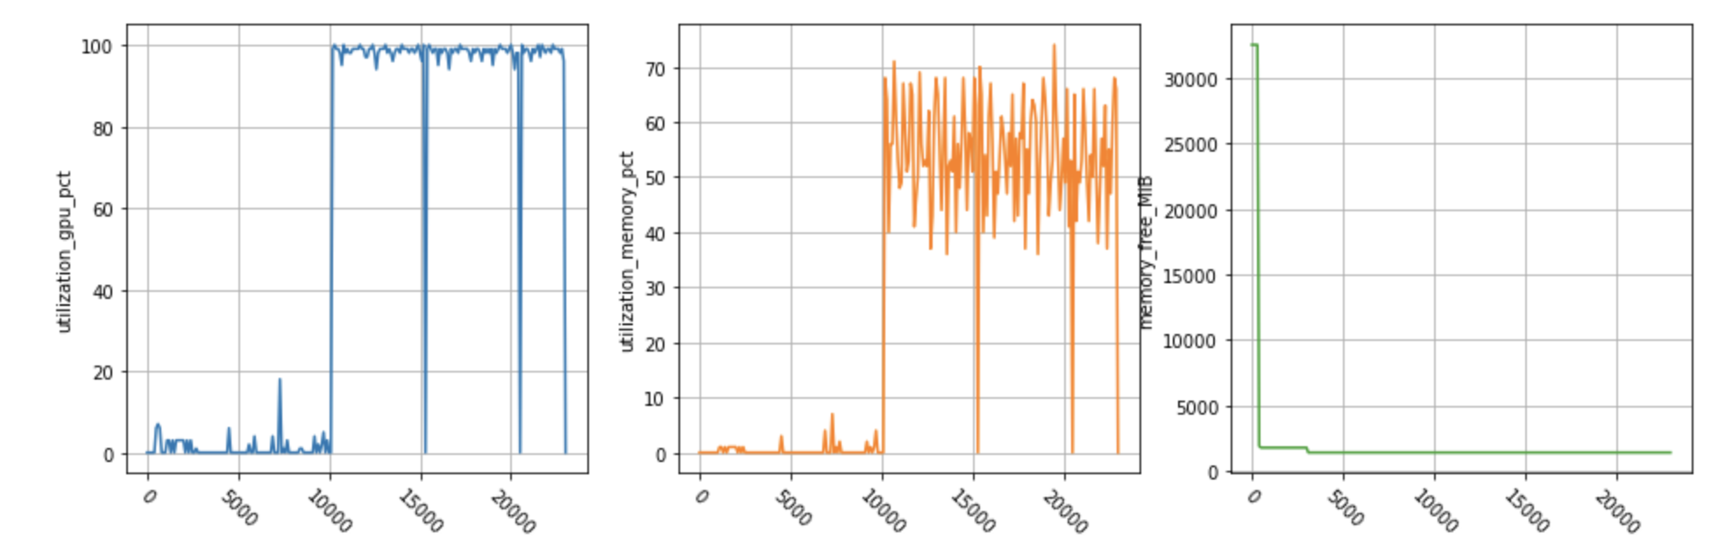
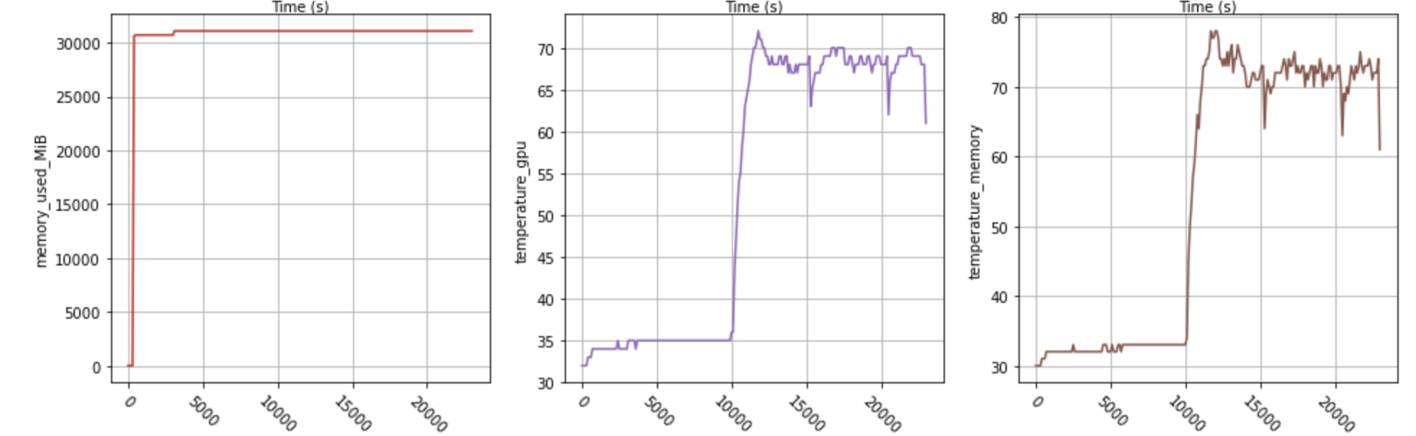
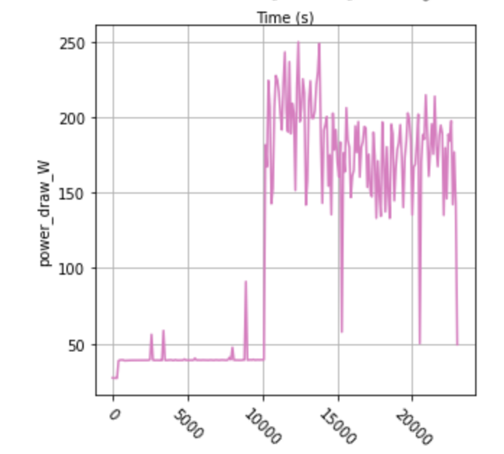
The MIT Supercloud Workload Classification Challenge
Workload classification helps to identify compute characteristics of unknown workloads and either present optimization pathways or alternatives to resource scheduling to minimize waste.
Data:
The MIT Supercloud Dataset consists of anonymized scheduler logs, time series data from CPUs and GPUs, monitoring data from each compute node. The uncompressed dataset is of the order of a Terabyte and is made available in compressed files. The dataset includes traces from 460,497 jobs, out of which 98,177 are jobs that requested GPUs for a variety of compute workloads which include AI/ML training and inference.
GPU:
The GPU utilization data is organized in 100 directories in the `gpu` folder. Each CSV file in these folders contains GPU usage data collected on all GPUs across all nodes assigned to a job. GPU data is collected using the `nvidia-smi` utility at 100 ms intervals.
How to use the GPU data: https://nbviewer.org/github/MIT-AI-Accelerator/MIT-Supercloud-Dataset/blob/main/notebooks/Intro-to-MIT-Supercloud-Dataset.ipynb
Notes:
在计算出矩阵X后，Gavel使用一个基于轮询的调度机制为每个模型分配资源，在每一个round结束后，会根据X(m, j)/模型m在加速器j上已经分配的时间片计算优先级，根据优先级高低决定下一轮的资源分配：

Slide 4
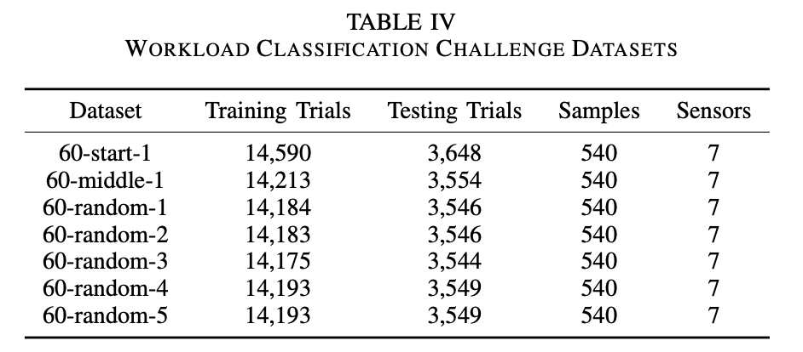
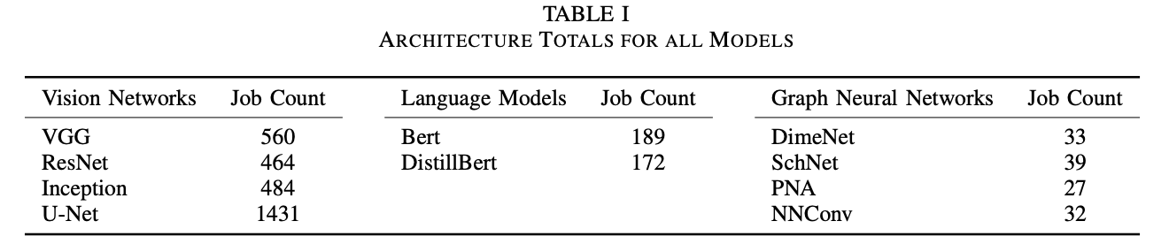
The MIT Supercloud Workload Classification Challenge
Detailed presentation of the MIT Supercloud Dataset’s labelled dataset:
The MIT Supercloud Dataset was collected on the TXGaia system, which is a heterogeneous cluster consisting of a set of GPU-accelerated nodes and another set of CPU-only nodes. The first partition has 224 nodes with two 20-core Intel Xeon Gold 6248 processors with a total 384GB of RAM and two NVIDIA Volta V100 GPUs with 32GB of RAM each.
The dataset consists of time series of CPU and GPU utilization, memory utilization, GPU temperature, snapshots of compute node state, file I/O, as well as the scheduler log.
At present, among the over 2 TB of data in the MIT Superclould Dataset, approximately 2 GB consist of labelled workloads, with 3,430 unique jobs. Found in labelled_jobids.csv.
The labelled data was created by running and manually labelling commonly used deep neural networks in vision, Natural Language Processing (NLP) and Graph Neural Networks (GNN). At present, there are ten deep neural network models in the labelled dataset as shown in Table I.
All data in the labelled dataset includes both CPU and GPU time series. Due to the fact a single job may request multiple GPUs across multiple nodes, the number of distinct GPU time series is larger than 3,430.
The features in the CPU and GPU datasets relevant to classification:
https://github.com/MIT-AI-Accelerator/MIT-Supercloud-Dataset/tree/main
The datasets were generated by sampling in three different ways: the first 60 seconds of each time series, the middle 60 seconds of each time series, and a 60 second sample drawn at random from the time series.
Each dataset is saved in the Numpy npz format and contains following the files: X_train, y_train, model_train, X_test, y_test, model_test.
Using the training sets as an example, X_train is a three dimensional vector containing the time series data. For example, in the 60-start-1 dataset, the dimensions are (14590, 540, 7) which correspond to trials, time series samples, and sensors respectively. Y_train is a vector of integer class labels. model_train contains the text names of the models corresponding to each numerical label in y_train.
Introduction:
Performance Heterogeneity: Commonly used models show heterogeneous performance behavior across accelerator types due to various architectural differences. Existing schedulers like Gandiva, Tiresias, and Themis do not consider this heterogeneous performance behavior.
Generality across Policies: Cluster operators might want to implement different scheduling policies based on their business goals, such as optimizing for time to complete a set of batch jobs (makespan), fairness for ad-hoc jobs, or more sophisticated hierarchical policies that divide resources among high-level entities (e.g., departments) using one policy, and then individual jobs within the entity using another
Colocation and Placement Optimizations:

Slide 5
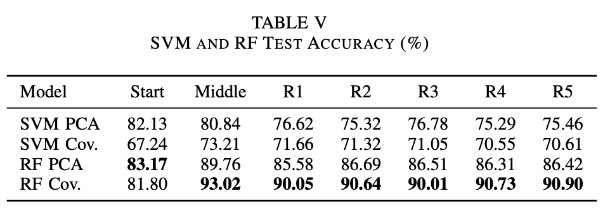
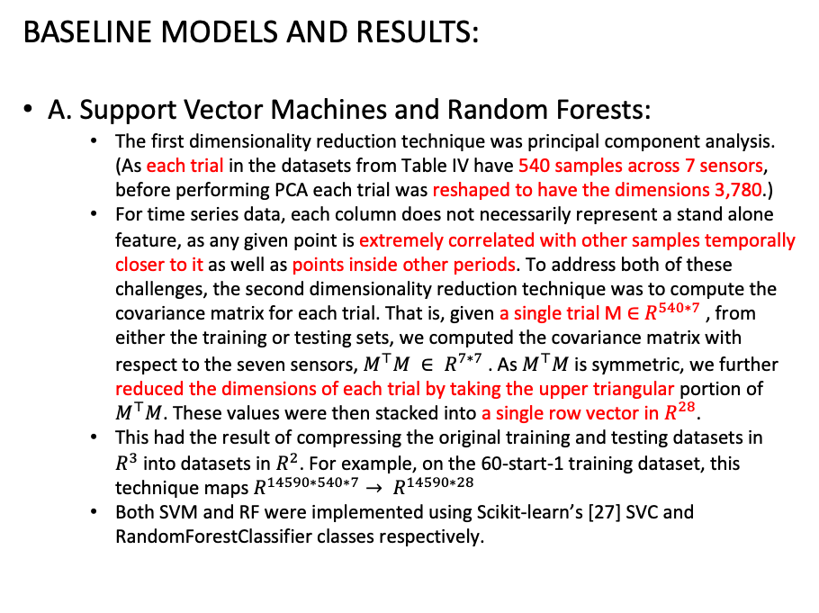
The MIT Supercloud Workload Classification Challenge
BASELINE MODELS AND RESULTS:
A. Support Vector Machines and Random Forests:
The first dimensionality reduction technique was principal component analysis. (As each trial in the datasets from Table IV have 540 samples across 7 sensors, before performing PCA each trial was reshaped to have the dimensions 3,780.)
For time series data, each column does not necessarily represent a stand alone feature, as any given point is extremely correlated with other samples temporally closer to it as well as points inside other periods. To address both of these challenges, the second dimensionality reduction technique was to compute the covariance matrix for each trial. That is, given a single trial M ∈ $R^{540∗7}$, from either the training or testing sets, we computed the covariance matrix with respect to the seven sensors, $M^{⊤}M ∈ R^{7∗7}$. As $M^{⊤}M$ is symmetric, we further reduced the dimensions of each trial by taking the upper triangular portion of $M^{⊤}M$. These values were then stacked into a single row vector in $R^{28}$.
This had the result of compressing the original training and testing datasets in $R^{3}$into datasets in $R^{2}$. For example, on the 60-start-1 training dataset, this technique maps $R^{14590∗540∗7}→ R^{14590∗28}$
Both SVM and RF were implemented using Scikit-learn’s [27] SVC and RandomForestClassifier classes respectively.
B. Regularizing Gradient-Boosting Classifier:
We evaluated its performance on the 60- random-1 dataset, applying standardization and covariance dimensionality reduction as in Section IV-A.
Our XGBoost model achieved a test set accuracy of 88.47% after 40 boosting rounds.
C. LSTM:
Prior to training, each dataset was standardized using Scikit Learn’s StandardScaler class as in Section IV. No other feature engineering or preprocessing was applied to the datasets.
We picked a fairly straightforward standard bidirectional LSTM architecture. A bidirectional LSTM trains two LSTMs on the input sequence, one from start-to-end, and the other in reverse.
The input sequence is fed into a bidirectional LSTM with a hidden layer size of 128 with all 7 sensors as the feature vector.
Then, the output of both LSTMs were concatenated and passed through a fully-connected layer projecting down to a feature size equal to the length of the sequence.
This was then passed through a dropout layer with p=0.5 to reduce overfitting, a leaky rectified linear unit (leaky ReLU) activation function as a non-linearity, and finally fed into another fully-connected layer that outputs a vector of size equal to the number of classes we are predicting.
Lastly, we apply a log-softmax transform on the output vector to get the log-probabilities of our classes.
Introduction:
Performance Heterogeneity: Commonly used models show heterogeneous performance behavior across accelerator types due to various architectural differences. Existing schedulers like Gandiva, Tiresias, and Themis do not consider this heterogeneous performance behavior.
Generality across Policies: Cluster operators might want to implement different scheduling policies based on their business goals, such as optimizing for time to complete a set of batch jobs (makespan), fairness for ad-hoc jobs, or more sophisticated hierarchical policies that divide resources among high-level entities (e.g., departments) using one policy, and then individual jobs within the entity using another
Colocation and Placement Optimizations:

Slide 6
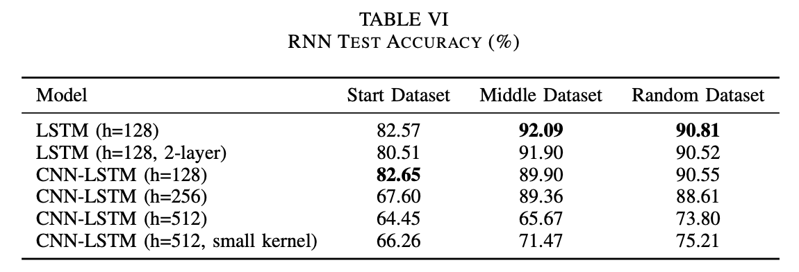
The MIT Supercloud Workload Classification Challenge
BASELINE MODELS AND RESULTS:
D. Applying Convolutions to LSTMs:
Prior to training, each dataset was standardized using Scikit Learn’s StandardScaler class as in Section IV. No other feature engineering or preprocessing was applied to the datasets.
We feed the input sequence into two 1-dimensional convolutional layers sandwiching a max pooling layer to reduce the dimensionality of the feature maps.
This output is then fed into the same bidirectional LSTM architecture from Section V-A and trained in the same manner.
Because the training time of RNNs increases with the length of the input sequence, this had the side benefit of speeding up training time by almost 8 times
Code for models:
The known workloads above used open source implementations and publicly available datasets as listed below:
- TensorFlow implementations of VGG, ResNet and Inception are available from https://github.com/tensorflow/benchmarks/tree/master/scripts/tf_cnn_benchmarks
These models were trained on the ImageNet dataset.
- U-Net models used here are described in the paper [_SEVIR : A Storm Event Imagery Dataset for Deep Learning Applications in Radar and Satellite Meteorology_](https://proceedings.neurips.cc/paper/2020/hash/fa78a16157fed00d7a80515818432169-Abstract.html), NeurIPS 2020. Implementations and dataset used for training are available from https://github.com/MIT-AI-Accelerator/neurips-2020-sevir.
- Pytorch implementations of Bert and DistillBert from the HuggingFace library were trained on fine tuning tasks. Available at https://huggingface.co.
- Pytorch implementations of DimeNet, SchNet, NNConv, and PNA are available in the `pytorch-geometric` package. For documentation see the following pages:
- https://pytorch-geometric.readthedocs.io/en/latest/_modules/torch_geometric/nn/models/dimenet.html
- https://pytorch-geometric.readthedocs.io/en/latest/_modules/torch_geometric/nn/models/schnet.html
- https://pytorch-geometric.readthedocs.io/en/latest/modules/nn.html#torch_geometric.nn.conv.NNConv
- https://pytorch-geometric.readthedocs.io/en/latest/_modules/torch_geometric/nn/conv/pna_conv.html
Introduction:
Performance Heterogeneity: Commonly used models show heterogeneous performance behavior across accelerator types due to various architectural differences. Existing schedulers like Gandiva, Tiresias, and Themis do not consider this heterogeneous performance behavior.
Generality across Policies: Cluster operators might want to implement different scheduling policies based on their business goals, such as optimizing for time to complete a set of batch jobs (makespan), fairness for ad-hoc jobs, or more sophisticated hierarchical policies that divide resources among high-level entities (e.g., departments) using one policy, and then individual jobs within the entity using another
Colocation and Placement Optimizations:

Slide 7
The MIT Supercloud Workload Classification Challenge
Plan of VM workload Classification:
Lessons learnt from other:
Classification Methods are not supervising. SVM, RF, XGBoost, LSTM, CNN+LSTM
RF Cov. Best performance, but hyperparamter tuning is very important.
Next Step:
If we have labelled data, we can do RF Cov. and other methods for classification. Tune the hyperparamters to achieve the best result
If we have unlabelled data, we can still try to do unsupervised learning methods to cluster them: KMeans Clustering, Gaussian Mixture Model, Ward Linkage Clustering
Introduction:
Performance Heterogeneity: Commonly used models show heterogeneous performance behavior across accelerator types due to various architectural differences. Existing schedulers like Gandiva, Tiresias, and Themis do not consider this heterogeneous performance behavior.
Generality across Policies: Cluster operators might want to implement different scheduling policies based on their business goals, such as optimizing for time to complete a set of batch jobs (makespan), fairness for ad-hoc jobs, or more sophisticated hierarchical policies that divide resources among high-level entities (e.g., departments) using one policy, and then individual jobs within the entity using another
Colocation and Placement Optimizations:

